Slide 1
Introduction to Computer Programming Lecture 8.1:
Intro to Matplotlib
Hemma Philamore
Department of Engineering Mathematics

Slide 2

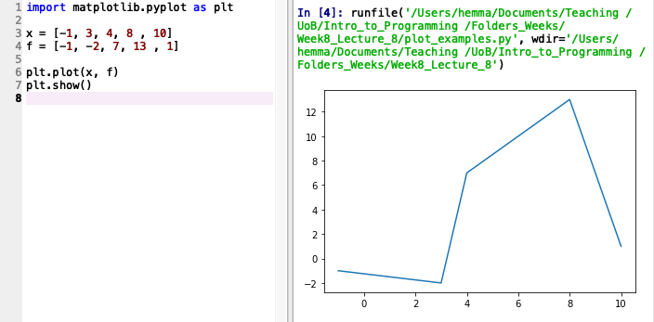
Visualising data
Output displayed in:
Plots window (run in Spyder)
Separate window (run in terminal)
Import the module
Line plot
Required to display plot

Slide 3
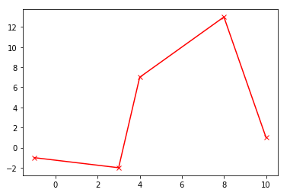

Formatting
Optional format string:
the colour of the plot (e.g. r = red, k= black)
the style of the markers (e.g. o = points, * = stars)
the style of the line (e.g. -- = dashes, . = dots)

Slide 4
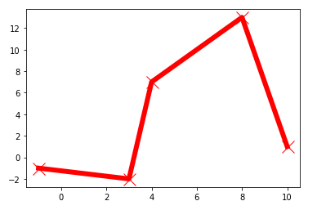
Formatting
Optional format string:
the colour of the plot (e.g. r = red, k= black)
the style of the markers (e.g. o = points, * = stars)
the style of the line (e.g. -- = dashes, . = dots)

Slide 5
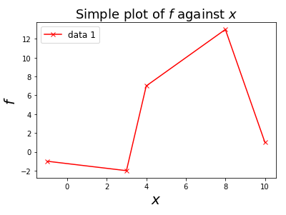
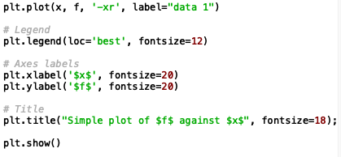
Axis Labels, Legend and Title
Notes:
Forgot to switch to spyder view when explaining titles etc

Slide 6
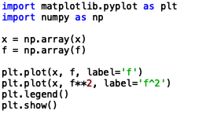
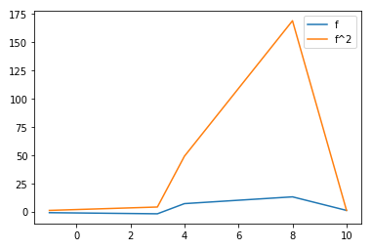

Multiple plots
Converting lists to arrays allows elementwise operations
Plots displayed on same axes

Slide 7
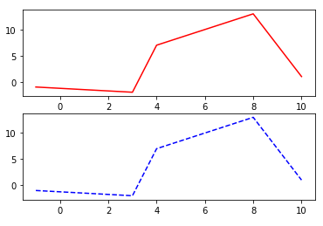
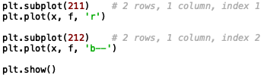
Sub-plots

Slide 8
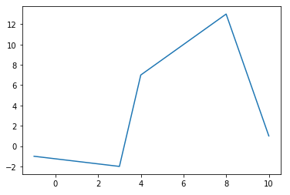

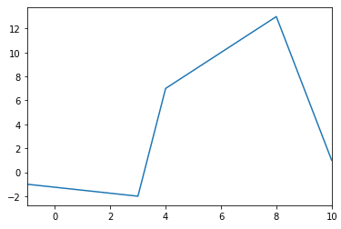

Setting Axis Limits

Slide 9
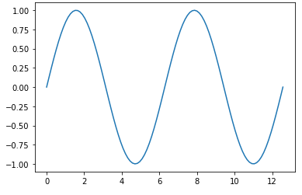
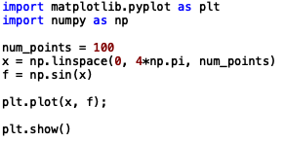
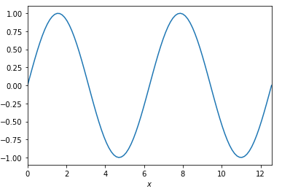
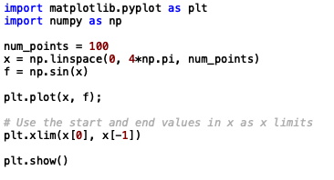
Setting Axis Limits

Slide 10
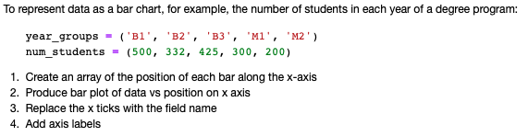
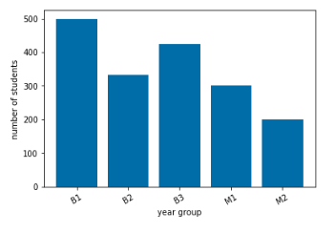
Bar Chart

Slide 11


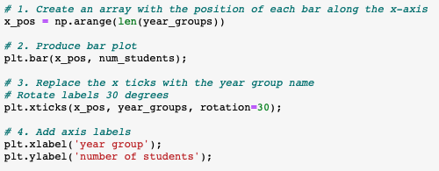
Bar Chart

Slide 12
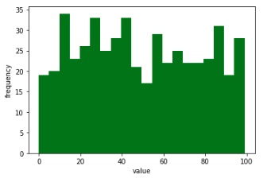
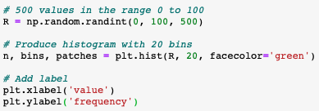
Histogram

Slide 13
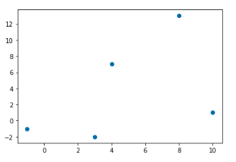

Scatter

